Slide 1
Any screen e-commerce using Responsive Web Design October 17, 2013
Author: Mike Lipman

Slide 2
Topics
Traditional view of m/e-commerce
Why “any screen” e-commerce?
Responsive Web Design explained
Pros/Cons/Considerations for going Responsive
Recommendation and next steps

Slide 3
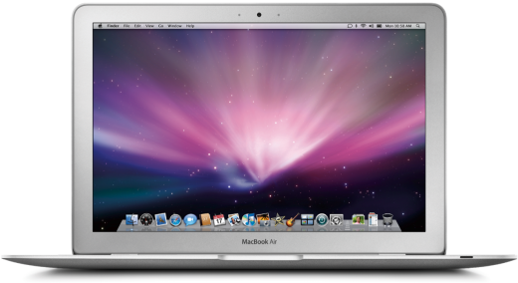
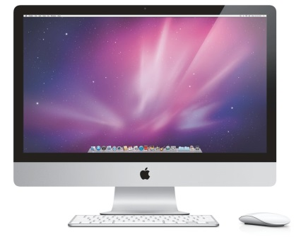
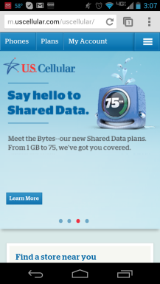
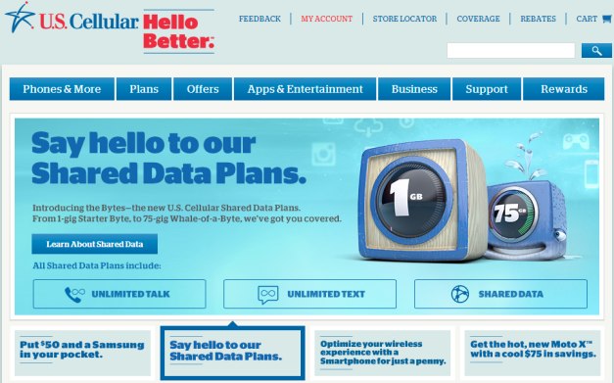
Traditional View Of m/e-commerce
Server plays traffic cop and determines which site is most appropriate
Request to view uscellular.com comes in from any device

Slide 4
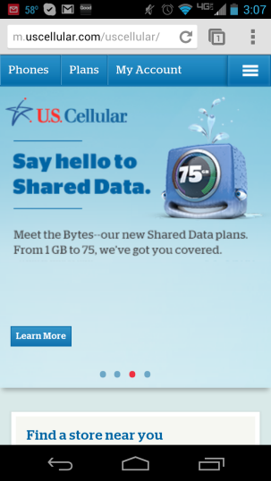
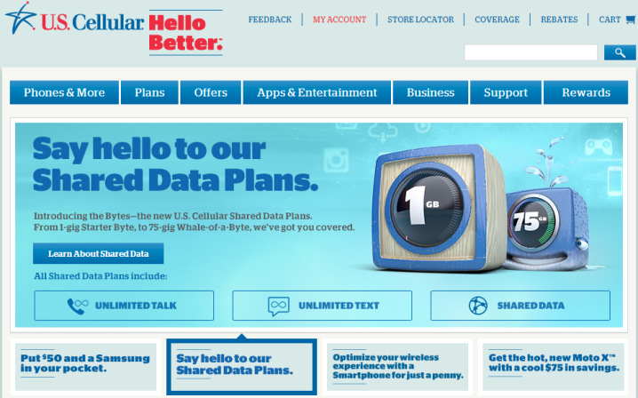
Traditional View Of m/e-commerce
m-commerce
e-commerce
A multi-site approach provides a viable m/e-commerce solution, but…..

Slide 5
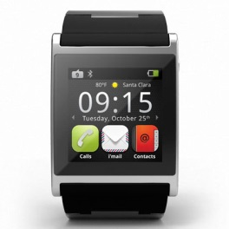
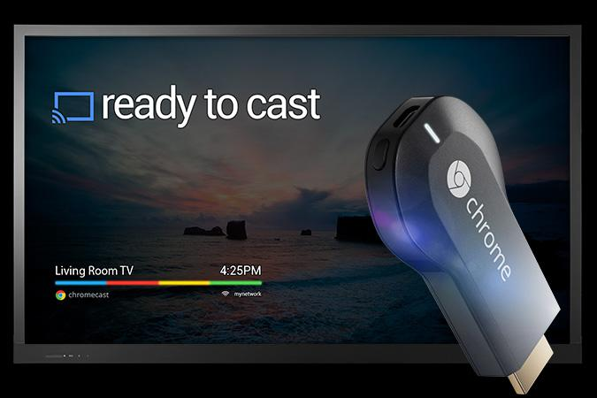
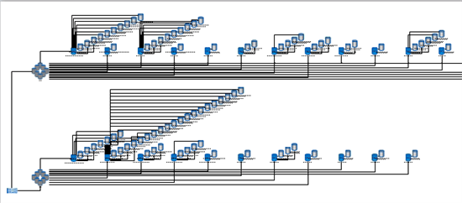
Traditional View Of m/e-commerce
Two (or more – “t-commerce”?) sites with unique URLs can hamper SEO
SEs must index multiple sites with similar or the same content
Separate code bases mean little to no sharing of assets
Linearly increases development + testing time as # of sites grows
Each site supports only a narrow range of screen widths
Entirely new sites may need to be built for a market-disrupting device
Server logic determines which site is rendered
Can get convoluted, resource intensive and impact performance

Slide 6
Let’s Take A Step Back.
And ask a “simple” question.
What is “Mobile”?

Slide 7
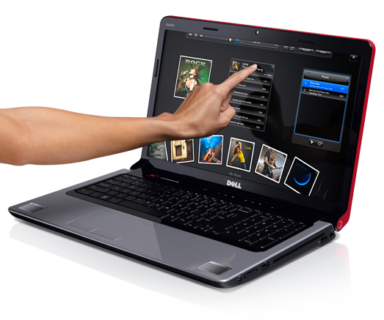
Everyone agrees this is a mobile device…..why is that?
Easy to take on-the-go / fit in pocket or purse
Touch-enabled
Small Screen (4”)
How about an iPad?
Or a Small Laptop?
Could this be “mobile”?
Good Portability
Touch-enabled
Large Screen (10.1”)
Decent Portability
Non-Touch
Approx. same screen as iPad (11”)
Somewhat Portable
Touch-enabled
X-large screen (17”)

Slide 8
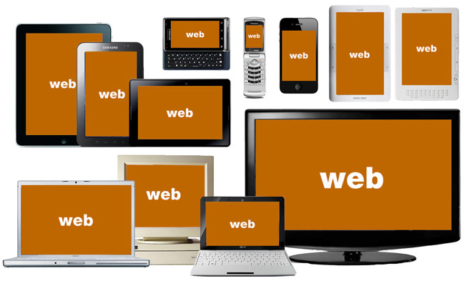
So…..What is Mobile?
The Answer:
It Doesn’t Matter
The device explosion of the past few years has made this semantic distinction largely irrelevant.
Key Points:
The site needs to function and represent the brand on (mostly) any screen that views it
The experience should be tailored to the physical capabilities of the device

Slide 9
Why “any screen” e-commerce?
The answer should be clear:
From smart watches to smart TVs and everything “smart” in-between, we must adapt our e-commerce experience to how customers choose to transact with us.
To do this well, remember the adage:
Or, at least it’s Queen
But Also….
Content Is King
Context Is King

Slide 10
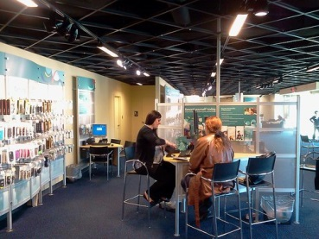
Why “any screen” e-commerce?
Tailored User
Experience
Content + Context =
This concept is well understood in other channels:
Retail
Telesales
Agent
Face-to-face interaction
Products can be seen/touched
All company functions available
Voice-only interaction
Products must be described
Most company functions available
Convenience of not having to travel to a physical location
Face-to-face interaction
Products can be seen/touched
Most company functions available
Augments retail by providing lots of convenient locations

Slide 11
Responsive Web Design Explained
Responsive Web Design (RWD) is a set of design principles and technologies that enables digital content tailoring based on the user’s context.
So, what does this mean in practice?
Context | 320 x 480 screen GPS Touch | 1024 x 768 screen GPS Touch | 1920 x 1080 screen No GPS Non-Touch
Content | “Just The Facts” One-column layout Small images Consolidated nav Location-specific | “Just The Facts+” Two-column layout Medium images Normal navigation Location-specific | “Facts + Everything” Three-column layout Large images Expanded navigation Hover = more info

Slide 12
Responsive Web Design Explained
But we could also accomplish this context/content tailoring with a traditional multiple site approach.
The “Big Idea” behind RWD is that you can do the same tailoring with just one site.
Think about water being poured from one container to another
If the containers represent the customer’s contexts and the water represents the site’s content….
RWD is the pouring mechanism
It mediates what content “flows” to devices (containers) of different sizes and capabilities & conforms the content to the dimensions of the device.

Slide 13
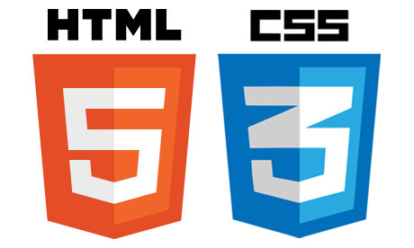
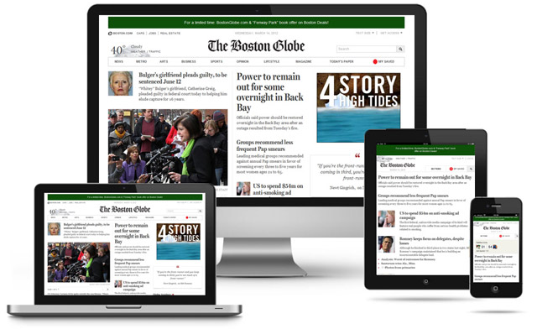
Responsive Web Design Explained
No one owns the principles or the tech behind RWD
It’s typically accomplished by leveraging open source code libraries and customizing as needed with standard web development techniques
The result can be beautiful….

Slide 14
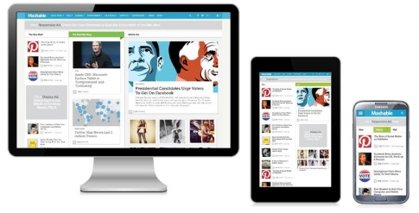
RWD Pros/Cons/Considerations
…but, it takes a significant investment in time + capital
First, let’s summarize RWD’s benefits relative to the multi-site approach:
1 site with 1 set of content improves SEO+SEM due to higher accessibility
Automatic adaptation to screen size & device capabilities – “future-friendly”
1 codebase = sub-linear increase in dev + testing as # of “sites” increases
No traffic cop = improved server performance for all pages

Slide 15
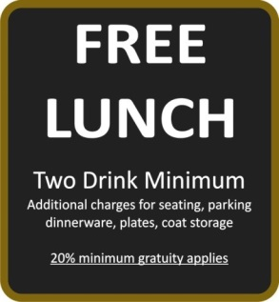
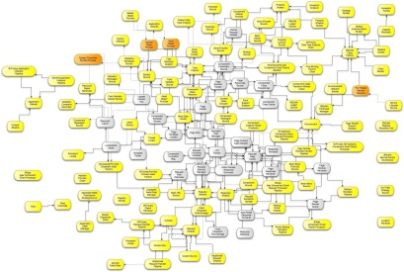
RWD Pros/Cons/Considerations
There are no free lunches
The down-sides of an RWD approach:
It’s expensive
Requires a full redesign of uscellular.com to do it “right”
2010 redesign only had desktop buy process in scope and did not consider “mobile” or My Account – at least 5x the cost
It’s complex
Non-traditional e-commerce process makes templating for multiple screens on one code base very challenging
4 generations of plan types supported in My Account, each having differentiated experiences and shopping logic
It will take time
Conservative estimate of a year at minimum
During this time the e-commerce team, as currently staffed, would only be able to support basic site updates

Slide 16
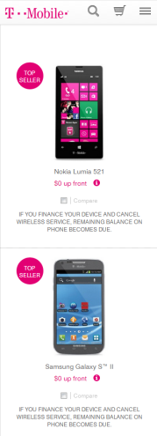
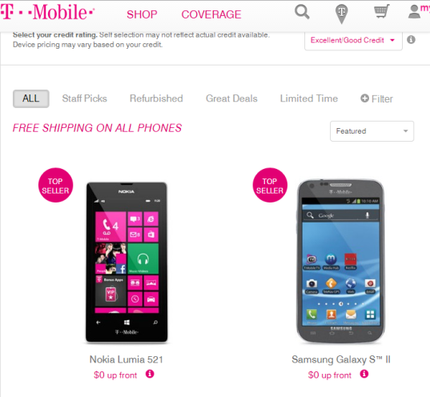
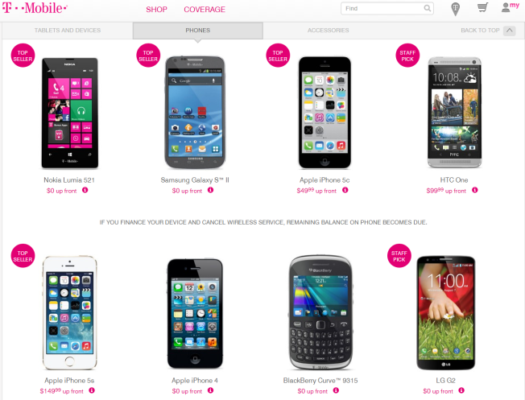
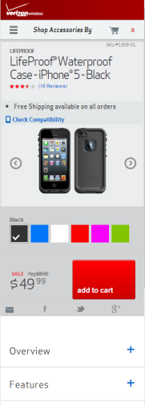
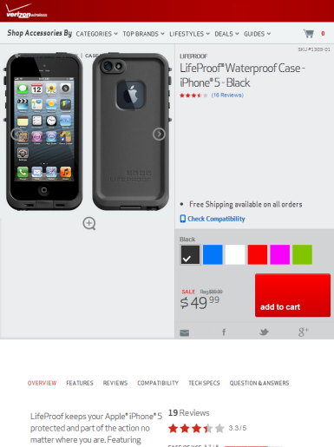
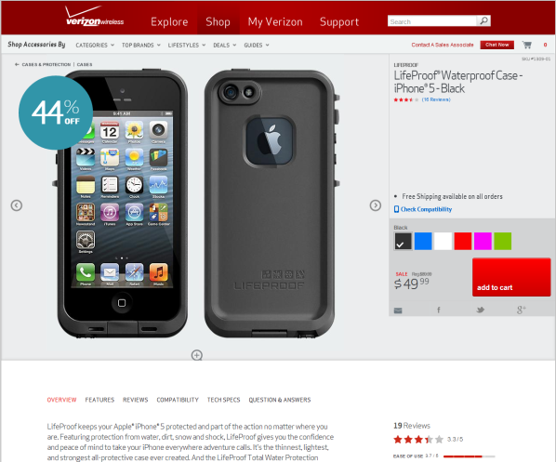
RWD Pros/Cons/Considerations
Other telcos are moving in this direction:

Slide 17
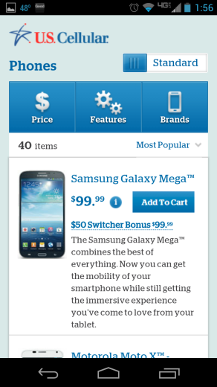
RWD Pros/Cons/Considerations
The presentation has focused on RWD but Multi-site has one advantage:
We can achieve “small screen” e-commerce more quickly and cheaply than with RWD.
Use roughly the same design and add e-commerce hooks + build out My Account shopping
Ultimately, the question is:
Multi-Site
- OR -
There is no practical middle ground that ensures a consistent user experience

Slide 18
Recommendation & Next Steps
The decision comes down to short-term vs. long-term costs/benefits
Uses a 10% Cost of Capital
Steady state costs for multi-site = ~2x of RWD due to multiple code bases
 | Discounted Cost | Year 1 | Year 2 | Year 3-∞
 | ~22m | 7.5m | 2m | 2m
 | ~22m | 15m | 2m | 1m
For
Illustration
Only!
Estimated ~2x cost for RWD vs. expanding multi-site to include e-commerce
Small spillover for development costs in Year 2 for RWD, then achieve a lower steady state thereafter

Slide 19
Recommendation & Next Steps
So over the long term,
the costs are roughly the same*
Both options will deliver a small screen e-commerce experience
But in moving forward with RWD, the organization would achieve:
E-commerce optimized for a wide variety of screens
A future-friendly design that can accommodate new devices with minimal impact
Opportunity for a fresh look/feel redesign
Improved SEO/SEM
While the term “Responsive Web Design” is the industry buzzword of the moment, the concept of dynamically adapting digital content to the customer’s context will be around for a very, very long time.
* A more thorough analysis should be performed to get a solidified estimate

Slide 20
Recommendation & Next Steps
How should we proceed from here?
Achieving a redesign using RWD requires commitments from senior leadership
$ to fund the initiative
Minimize site changes during project’s timeline
Active involvement in the site’s construction
Invest in the e-commerce team to maintain and build upon the redesigned site once launched
Partner with a world-class web design + technology vendor
Leverage expertise in designing a UX for varied devices
Select & configure technologies to build out RWD at a large scale

Slide 21
Thank You!

